Slide 1
Forecasting Stock Prices Using News Headlines
Daniel Felberg
George Washington University

Slide 2
Literature Review (1)
Marketing Research
Corporate Reputation
How well a firm/company is perceived by the mass public in general
Paid vs. Owned vs. Earned Media
Earned Media
Any public exposure a company may receive from media coverage
Problem → existing research focuses on Corporate Repuation generally, less so on earned media specifically
Alloza, Carreras, and Carreras (2014), Fernández-Gámez, Gil-Corral, Galán-Valdivieso (2016)
Goal: help demonstrate relationship between earned media and how it impacts a firm’s finances (i.e. stock prices)

Slide 3
Literature Review (2)
Sentiment Analysis and Time-Series Forecasting
Hassan (2022) → forecasted directional movement of the S&P500 using Twitter data more successfully than baseline models
Advancement of LSTM models
Bu, Li, Li, and Wu (2020) → successfully forecasted with high accuracy the next-day opening prices of the CSI 300 index using messages posted to Eastmoney.com, a Chinese stock message board
Asgarov (2023) → forecasted Tesla’s and Apple’s stock prices using Twitter data
Reiterating Goal: help model relationship between news media (i.e. earned media) and stock prices

Slide 4
LSTM Models Explained
Long Short-Term Memory (LSTM) is a deep recurrent neural network (RNN) method
How they work:
Highlighter: marks important things
Eraser: deletes things that are no longer important
Pencil: writes down new things you learn
You are reading a book one sentence at a time:
Day 1 → weather is sunny, highlight for predicting weather tomorrow
Day 2 → weather is cloudy, erase “sunny” and write “cloudy” instead
Day 3 → weather is raining, update book once again

Slide 5
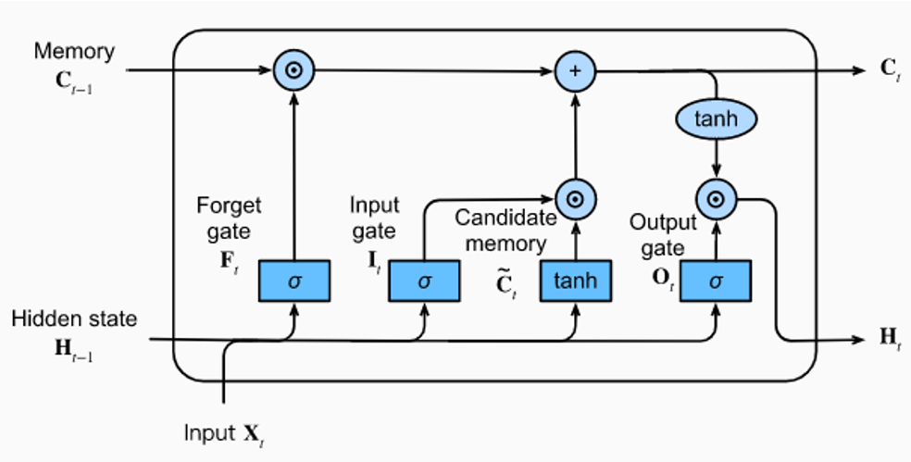
LSTM Models Explained 2

Slide 6
Data Collection
Three steps:
1) Scraping news headlines
Custom scraper (`Beautiful Soup`) → Financial Times
2) Perfom sentiment analysis
`distilroberta-finetuned-financial-news-sentiment-analysis`
3) Fetch daily closing stock
Yahoo Finance API
Top 10 companies globally by market cap

Slide 7
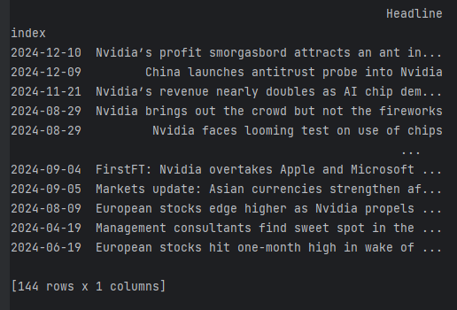
Scraping News Headlines
Using `Beautiful Soup` to scrape from Financial Times website
Scraper accesses “search” URL, and iterates through the pages
Returns headlines and their date of publication as an index:

Slide 8
Sentiment Analysis
`distilroberta-finetuned-financial-news-sentiment-analysis`
Model was trained specifically on a dataset consisting of 4,840 financial news sentences from the English language
Ideal fit for our needs!
For every headline, returns “Label” (positive, neutral, negative) and “Score” (respective label’s score)
Re-map labels to 1, 0, -1 (respectively)

Slide 9
Stock Data
Yahoo Finance API → obtained stock data from top 10 global companies by market cap
NVIDIA
Apple
Microsoft
Amazon
Google
Aramco
Facebook
Berkshire Hathaway
TSMC
Tesla
Returns daily closing stock data and date index for each value

Slide 10
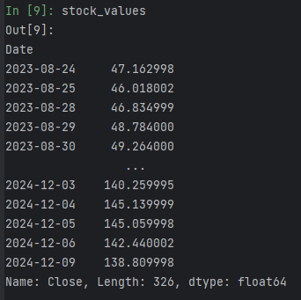
Data Structures
Index | Headline | Label | Score | Numeric Label
'2024-12-09' | China launches antitrust probe into Nvidia | Neutral | 0.998862 | 0
'2024-11-21' | Nvidia’s revenue nearly doubles as AI chip dem... | Positive | 0.999671 | 1
'2024-08-29' | Nvidia brings out the crowd but not the fireworks | Neutral | 0.999871 | 0
'2024-08-29' | Nvidia faces looming test on use of chips | Neutral | 0.998440 | 0
'2024-12-03' | The geopolitics of chips: Nvidia and the AI boom | Neutral | 0.999856 | 0

Slide 11
Methodology (Develop LSTMs)
Four models were developed:
For all models: sequence length/time steps = 1, epochs=20, batch size = 32
Train/Test split set to 80/20
LSTM1 (no headlines)
LSTM2 (no headlines)
LSTM3 (with headlines)
LSTM4 (with headlines)
Layer | Parameter
Input | (1,1)
LSTM | 25
LSTM | 25
Dense | 25
Dense | 1
Layer | Parameter
Input | (1,1)
LSTM | 25
LSTM | 25
Dense | 1
Layer | Parameter
Input | (1,2)
LSTM | 25
LSTM | 25
Dense | 25
Dense | 1
Layer | Parameter
Input | (1,2)
LSTM | 25
LSTM | 25
Dense | 1

Slide 12
Challenges Encountered: Joining Headline and Stock Data
Problem: several dates had more than one news article published
Example (Microsoft):
Solution: create “padding” so all lists are the same length (using netural value of `0`)
Disadvantage: forced to “compress” values back down using mean
“Mutes” potential noise in the data
Something to keep in mind going forward!

Slide 13
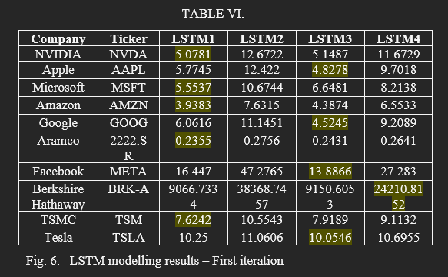
Results 1

Slide 14
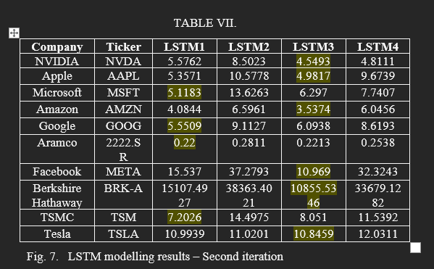
Results 2

Slide 15
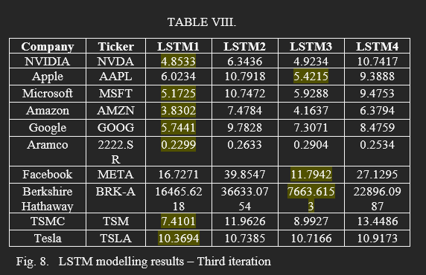
Results 3

Slide 16
Conclusion
Models are not conclusive enough to help establish a direct relationship between earned media and stock prices
BUT, results also show it may be possible to improve models using more complex LSTMs
More layers!

Slide 17
Next Steps and Areas of Improvement
Go beyond `distilroberta-finetuned-financial-news-sentiment-analysis` → use other text classification tools
Models with more layers, or additional hyperparameter tuning
Introduce more news headline scrapers!
Utilize less-obvious, financial metrics, such as goodwill share price, intangible assets
Inconsistency in model performance:
Collected data changes based on new articles that are written, and new daily closing prices → unreliable!
In the future, establish definite dates and extract news/stock data between those dates

